Slide 1
Search Technology – Group 2
sergeyj@ifi.uio.no

Slide 2
Today’s Agenda
Fiercest derby in Norwegian football
The ranker formula
Exam stats + tips
Book of the week

Slide 3
Lsk - vif
Lillestrøm vs. Vålerenga
Traditionally, Vålerenga has been the better team

Slide 4
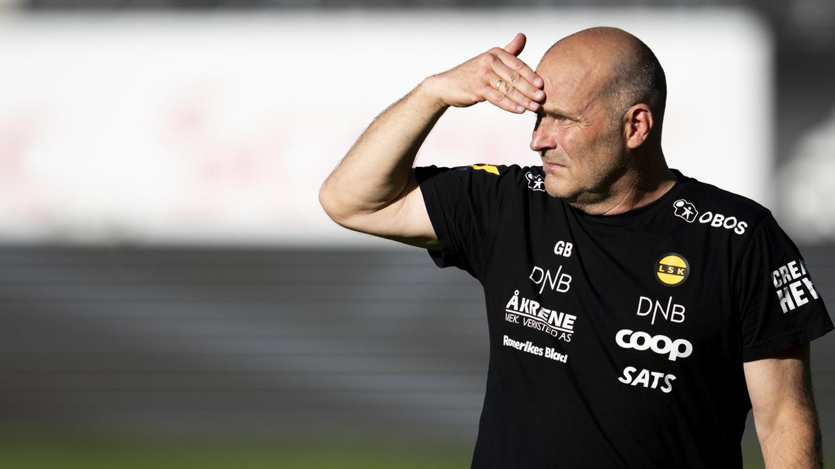
Enter geir bakke
Joined Lillestrøm 4 years ago
Promoted
Two 4ths
Cup final last year

Slide 5
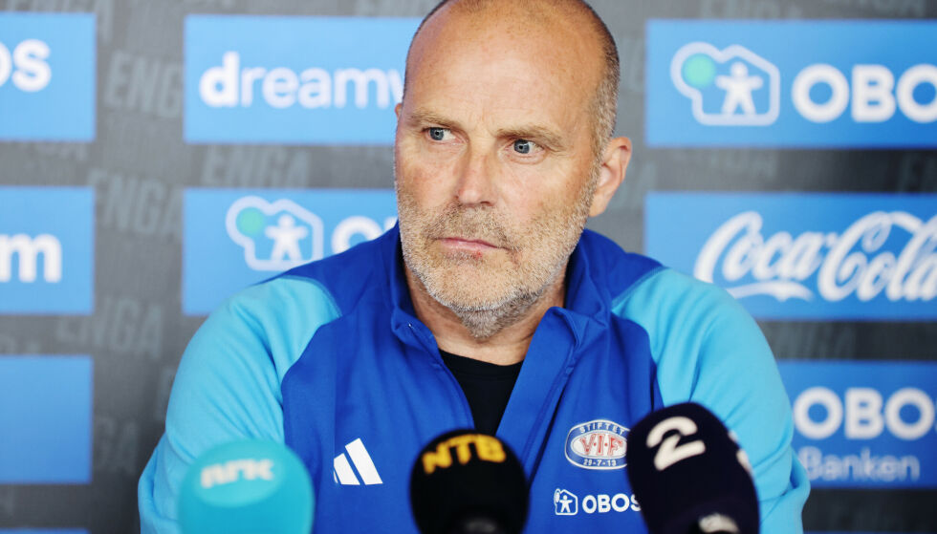
Biggest shock in history
Joins Vålerenga mid season for a pay rise
Blames LSK players

Slide 6
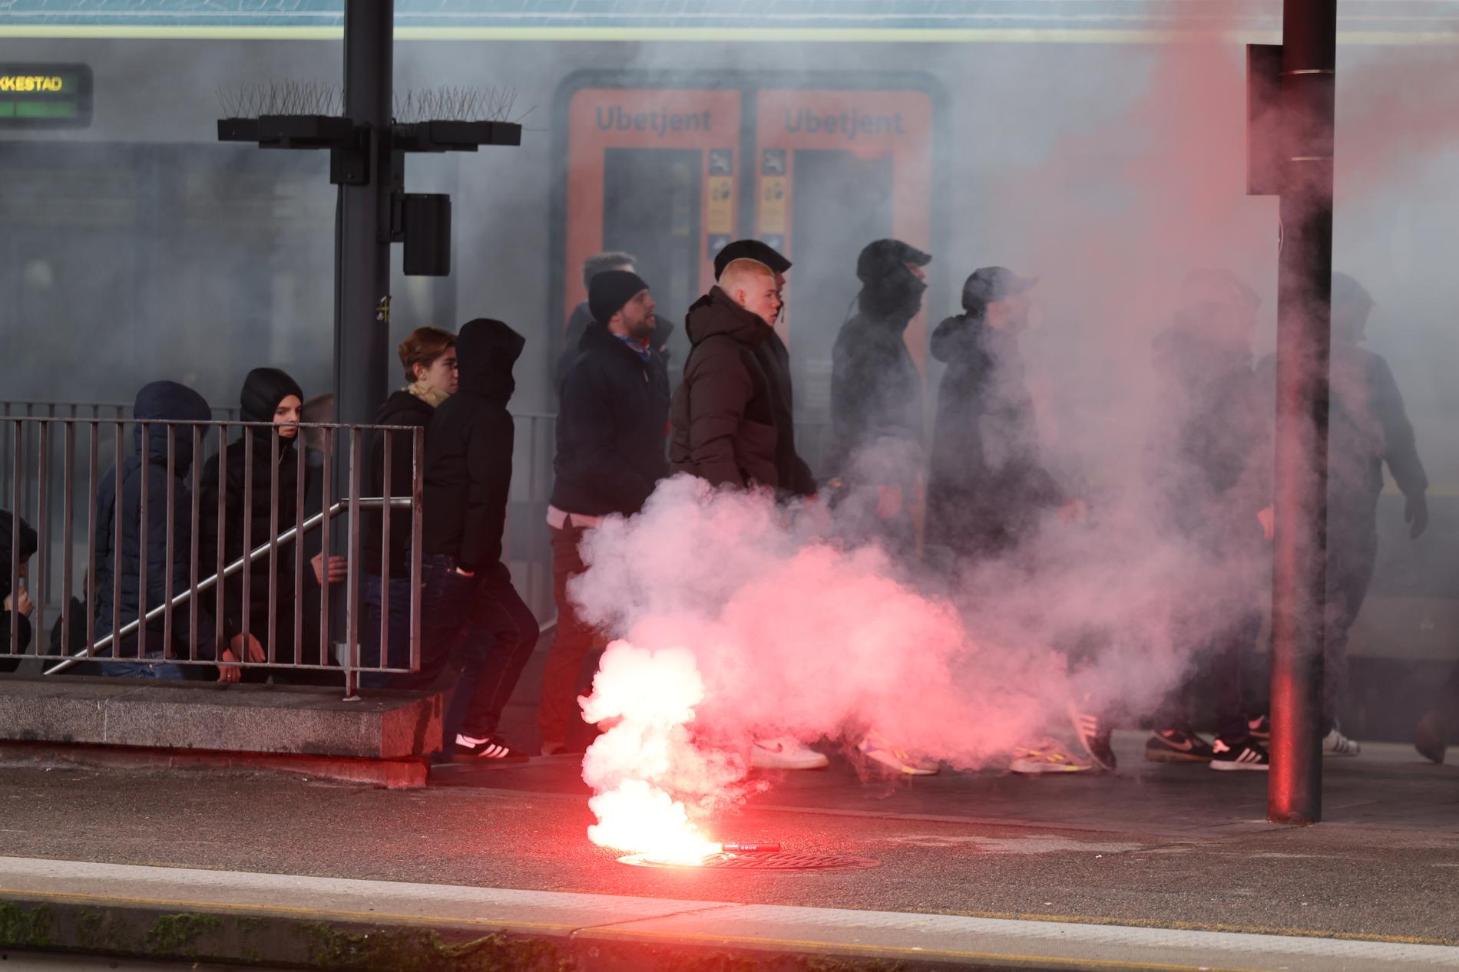
First derby after transfer

Slide 7
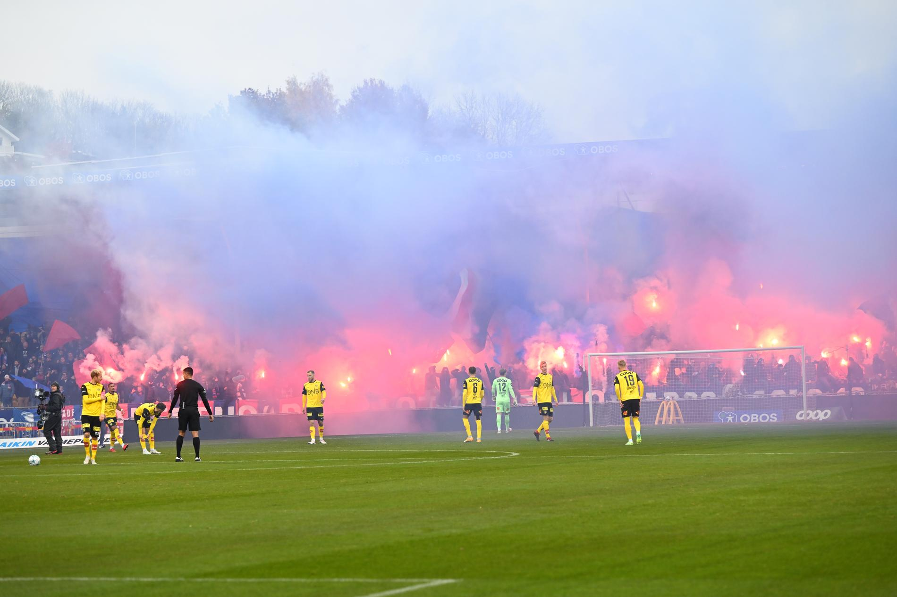
First derby after transfer

Slide 8
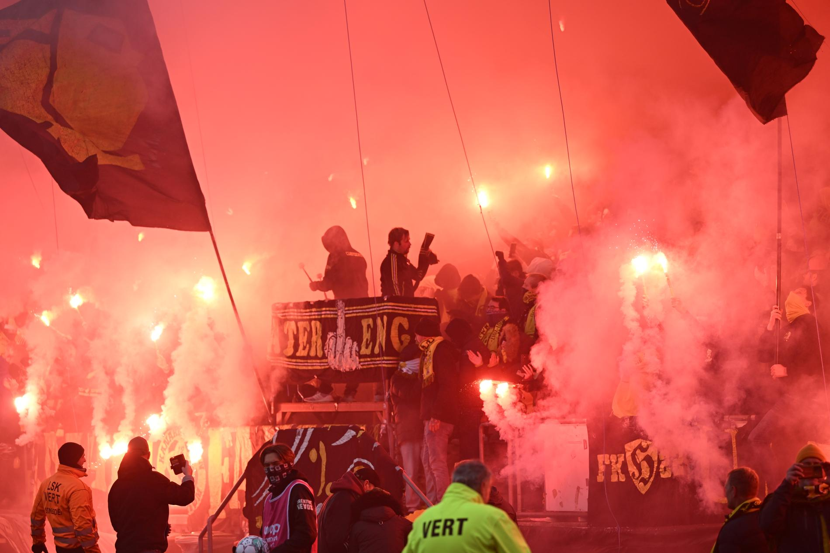
First derby after transfer

Slide 9
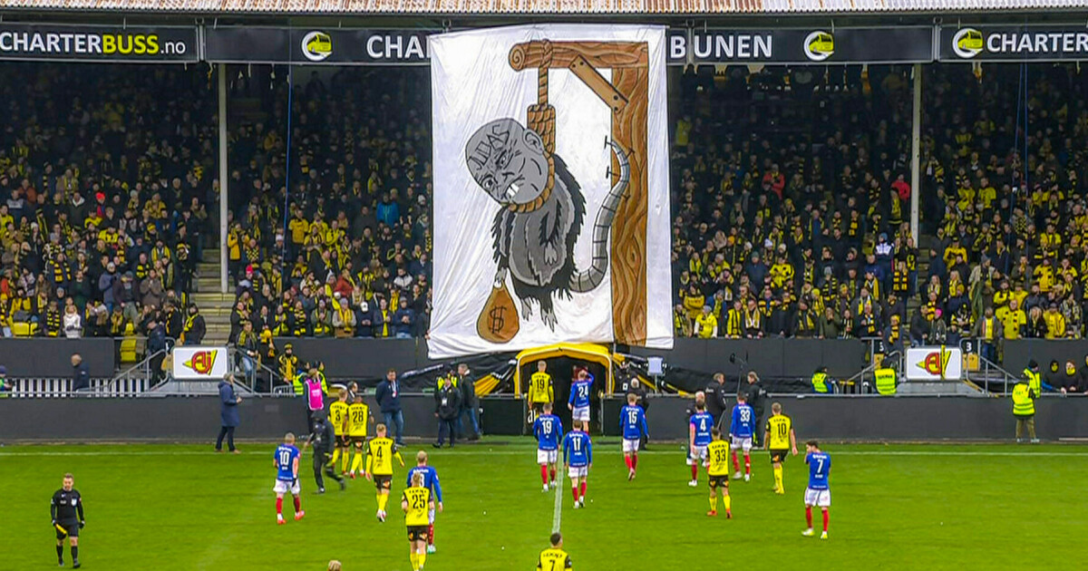
First derby after transfer

Slide 10
Today’s Agenda
Fiercest derby in Norwegian football
The ranker formula
Exam stats + tips
Book of the week

Slide 11
the ranker formula
Tf-idf
Term frequency x Inverted document frequency

Slide 12
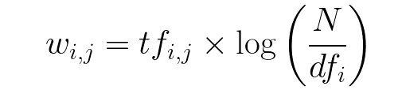
Tf-idf

Slide 13
Term frequency
def update(..., posting: Posting):

Slide 14
Term frequency
class Posting:
def __init__(self, ..., term_frequency: int):
...
self.term_frequency = term_frequency

Slide 15
Inverted document frequency
log = math.log
N = len(self._corpus)
df_{i} = ... check out invertedindex.py

Slide 16

Net score
g(d) = self._score * self._static_score_weight

Slide 17
Today’s Agenda
Fiercest derby in Norwegian football
The ranker formula
Exam stats + tips
Book of the week

Slide 18
Most common topics
Suffix arrays 7/12 4/6
MAP 6/12 5/6
SVM 6/12 4/6
Heap’s law 6/12 3/6
NDCG 6/12 3/6

Slide 19
/ without home exams
Suffix arrays 6/10 3/6
SVM 5/10 3/6
Heap’s law 5/10 2/6
MAP 4/10 3/6
T-a-a-t 4/10 3/6

Slide 20
"Always"
Classification (SVM, Rocchio, Naive Bayes etc.)
Evaluation (MAP, NDCG, F1-score etc.)
Strings (Suffix arrays, Edit distance etc.)
Link analysis (Random surfer model, probability matrix etc.)

Slide 21
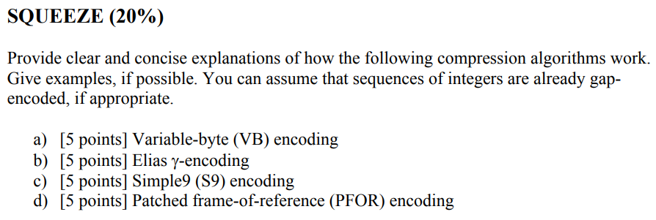
compression

Slide 22
Exam tips
Practice the stuff you find the least entertaining

Slide 23
Exam tips
Discuss the curriculum with others

Slide 24
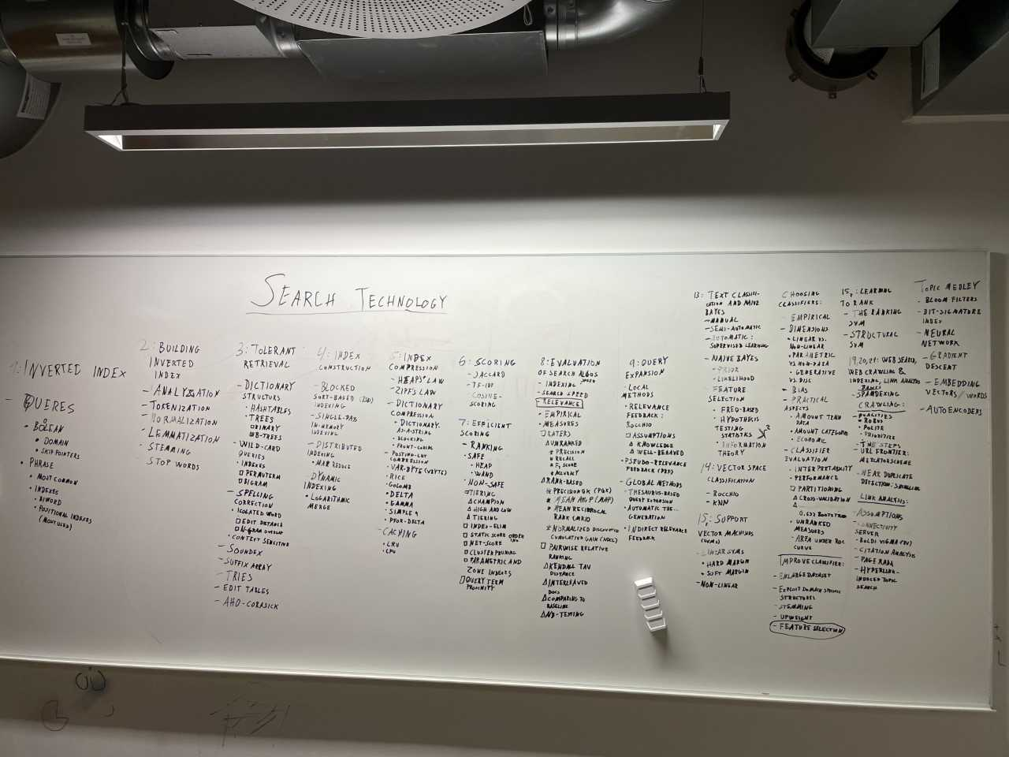
Whiteboard sessions

Slide 25
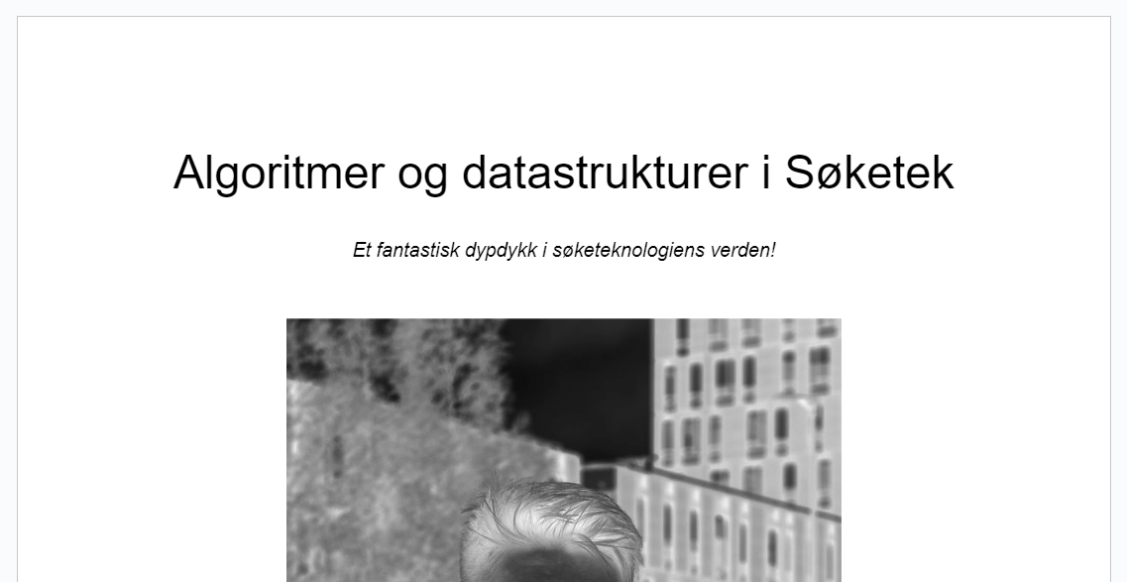
Casual discussions

Slide 26
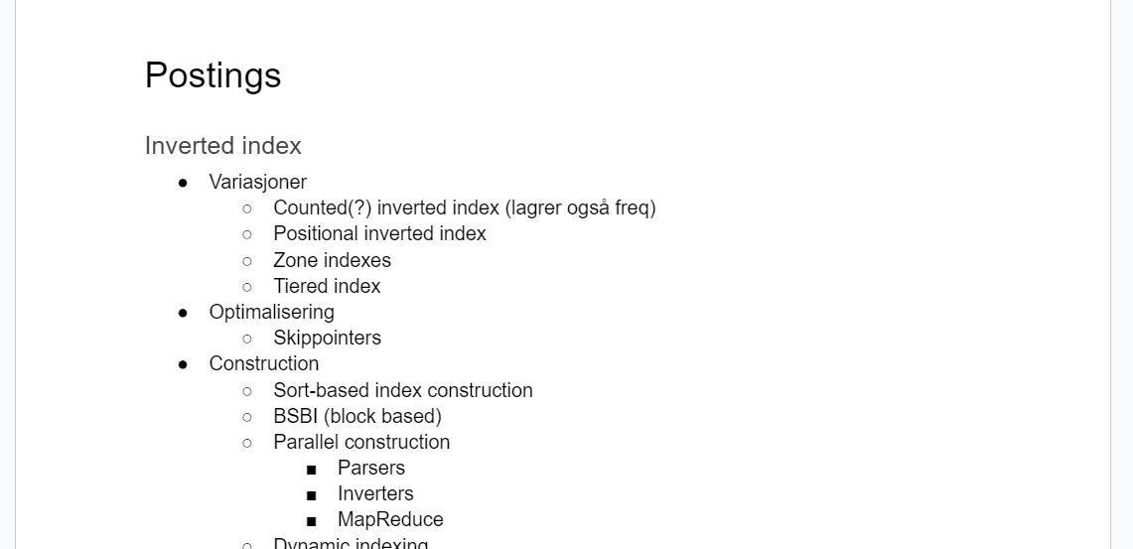
Casual discussions

Slide 27
Exam tips
Go through the slides and write the info down in your own words
If anything is unclear, watch the videos from 2020
Or watch YouTube videos

Slide 28
Exam tips
Attempt at solving previous exams
Make it realistic: Set a timer and turn off the wifi

Slide 29
Today’s Agenda
Fiercest derby in Norwegian football
The ranker formula
Exam stats + tips
Book of the week

Slide 30
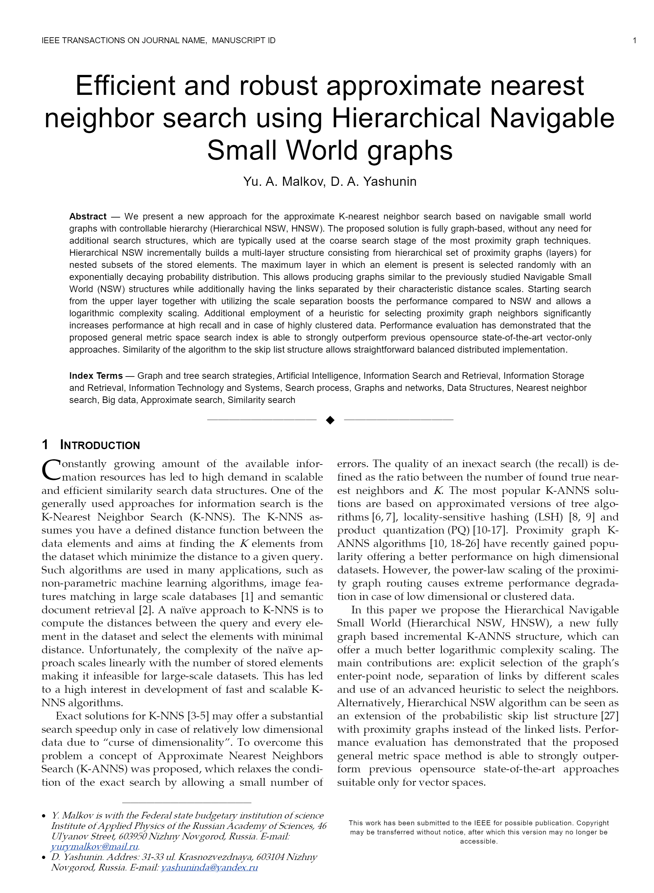
Book paper(s) of the week
Approximate Nearest Neighbour
Anyone
Why?
Introduced this semester
Not covered by the book
NOT the same as K-nearest neighbours

Slide 31
Today’s Agenda
Fiercest derby in Norwegian football
The ranker formula
Exam stats + tips
Book of the week

